Slide 1
Neonatology Procedure Standardization to Improve Safety NEOPROS Project: modified for ACTS
Joint Neonatology Education Program
Department of Paediatrics, University of Toronto

Slide 2
Objectives for Today’s Session
Improve the safety of umbilical
catheter insertion through the
implementation of a standardized training program
Indications & contraindications for line insertion
Anatomy, Line Positioning
Equipment
Challenges
Patient/Staff Preparation (video)
Procedure (video)
Demo (sterile preparation, procedure including suturing / bridging)
Practice

Slide 3
Target Areas for Patient Safety
Promotion of aseptic technique
Increase insertion success
Minimizing line mal-position
Reduction of complications

Slide 4
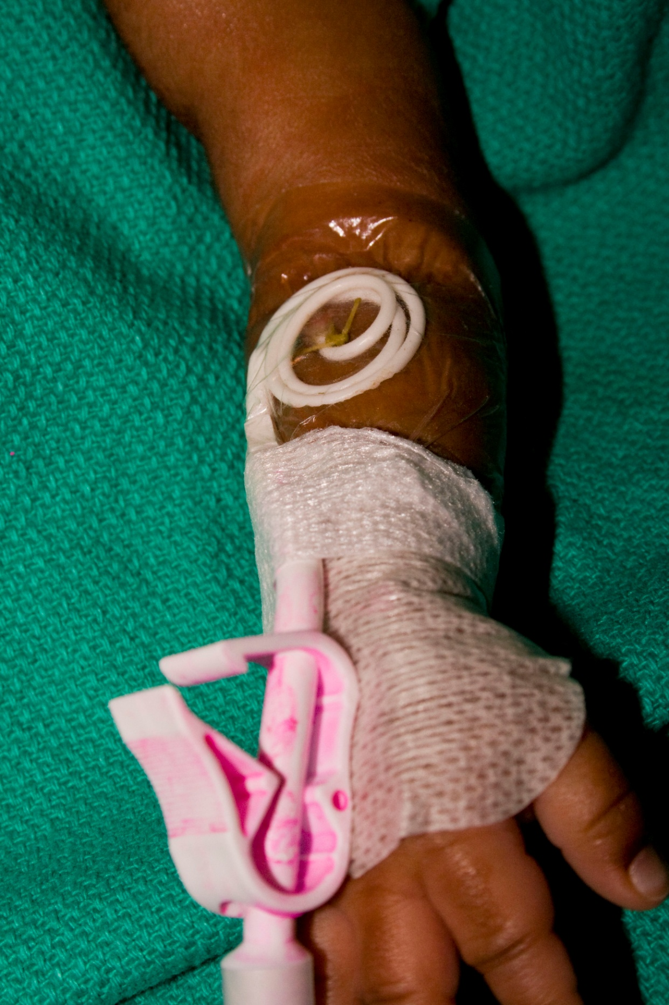
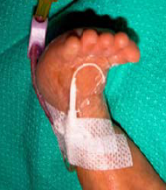
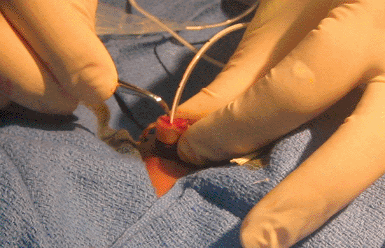
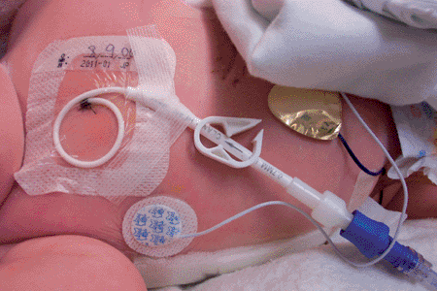
Types of Vascular Access
IGT PICC: image guided therapy PICC
PICC: peripherally inserted central catheter
CVC: central venous catheter
UVC: umbilical venous catheter
UAC: umbilical arterial catheter

Slide 5
Umbilical Catheters

Slide 6
Indications
UVC
UAC
Emergency vascular access
IV fluids and medications
CVP monitoring
Exchange transfusion
Frequent arterial blood gases or blood sampling
Continuous BP monitoring
Resuscitation
Exchange transfusion

Slide 7
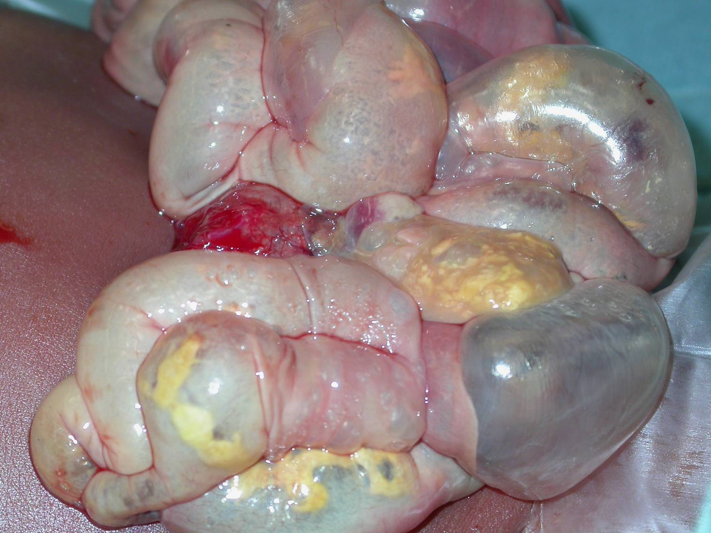
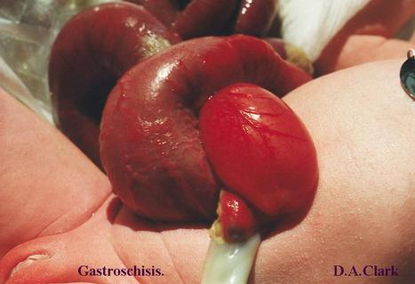
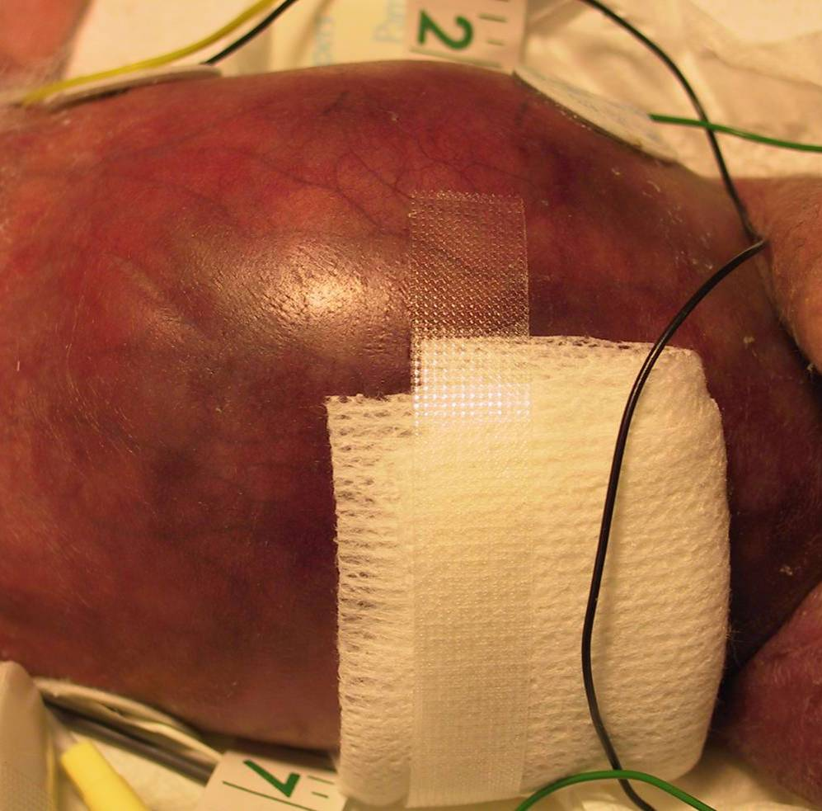
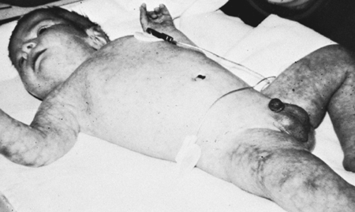
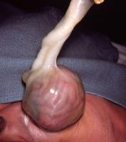
Umbilical Catheter Contraindications
NEC
gastroschisis
peritonitis
omphalocoele
UAC: vascular compromise lower limb or buttocks
omphalitis

Slide 8
Duration of Umbilical Catheterization
Remove as soon as no longer required
Remove UAC if signs of vascular compromise to lower extremities or buttocks
UAC*: Ideally should be removed after 5 days
UVC*: Can remain in place up to 14 days (if in good position and treated aseptically)
*CDC Guidelines 2002

Slide 9
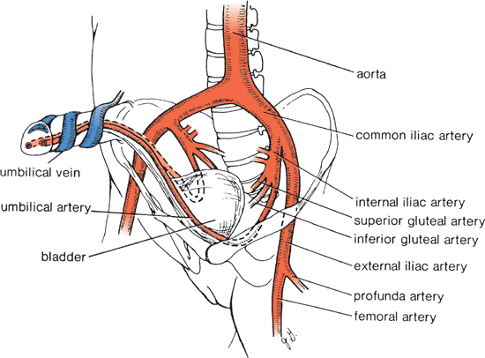
Anatomy
Notes:
2 arterial vessels and 1 vein – vein is thin walled, in full term infant is about 2-3 cm in length and 4 – 5 cm in diameter, positioned at approx 12 o’clock. From the umbilicus it passes cephalad and a little to the right –where it joins the left branch of the portal vein – sprouting off several large intra-hepatic branches distributed directly into liver tissue.
Arteries are smaller with thicker muscular walls, full term infant about 7 cm in length and 2 – 3 mm in diameter. positioned approximately at 5 and 7 o’clock. A catheter will pass into the ascending aorta via the internal iliac artery. Occasionally it may pass into the femoral artery via the external iliac artery (which is not to be used and should be removed).

Slide 10
Vein
Arteries
Umbilical Vein | Umbilical Artery
One vein | Two arteries
Thin-walled vessel | Thicker muscular walls
Larger and less round than umbilical arteries | Smaller
In a full-term infant: ~ 2 to 3 cm in length 4 to 5 mm in diameter | In a full-term infant ~7 cm in length 2 to 3 mm in diameter
Located close to periphery of umbilical stump at ~12-o’clock

Slide 11
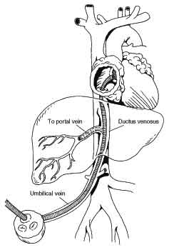
Course of Umbilical Vein
Narrow, poor alignment
Principles of Pediatric Surgery. 2003
AJR 2003; 180:1147-1153
Notes:
From the umbilicus, it passes cephalad and a little to the right, where it joins the left branch of the portal vein after giving off several large intra-hepatic branches that are distributed directly to the liver tissue

Slide 12
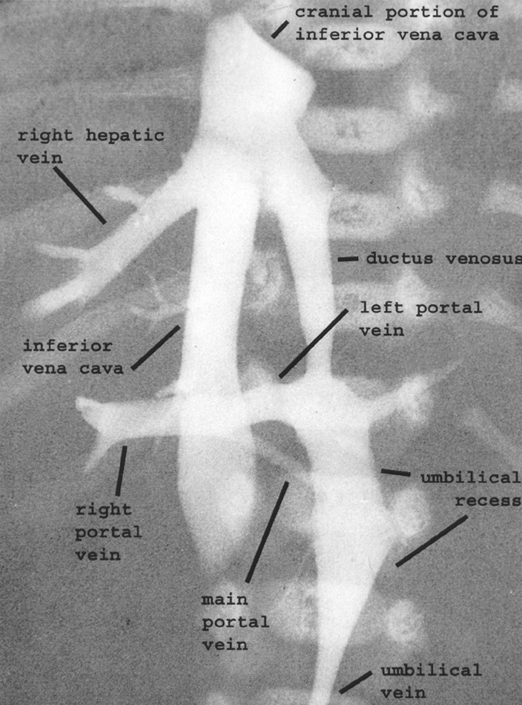
Ideal Course of UVC

Slide 13
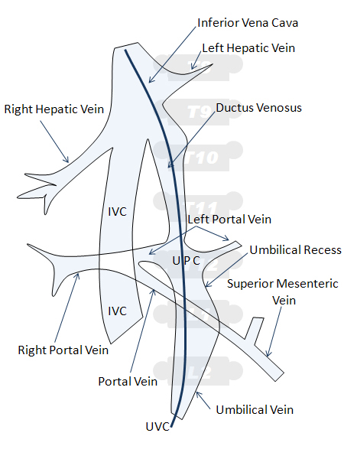
Positioning of UVC
Malposition rates high (55%)
Arch Pediatr 2010
Place in inferior vena cava outside right atrium
Do not leave UVC in right atrium (approx T7)
Do not leave UVC near portal vein (approx T11)
Positioning in ductus venosus is acceptable except for measurement of central venous pressure
T7 ~RA
T8-9 ~RA-IVC
T9-10 ~ IVC
Bradshaw. Adv Neo Care 2006;6(3):127
Meerstadt. (2000). Manual of Neonatal Emergency X-Ray Interpretation

Slide 14
Course of Umbilical Artery
Notes:
A catheter introduced into the umbilical artery will usually pass into the ascending aorta from the internal iliac artery. Occasionally, it may pass into the femoral artery via the external iliac artery, which becomes an unsuitable site for blood sampling, pressure monitoring, or infusion and should be removed.

Slide 15
Umbilical Catheters
Use single hole catheters only
Reduces surfaces for potential thrombus formation
Use single lumen catheters for UAC’s
Multiple lumen catheters only for UVC’s
Use of feeding tubes NOT recommended
Higher incidence of thrombosis
Exception: emergency situations in less resourced settings when umbilical catheters unavailable

Slide 16
Catheter Size
<1.5kg: 3.5-Fr gauge
≥1.5kg: 5-Fr gauge

Slide 17
High Versus Low UAC Positioning
High positioning preferred
Low positioning associated with increased vascular complications
If high positioning cannot be established, low positioning may be used
Barrington KJ. Cochrane 2009
Clin Perinatol 2005;32:141–156

Slide 18
Positioning of UAC
High position
Catheter tip at level of thoracic vertebrae 6 to 9
Tip above celiac axis
Low position
Catheter tip at level of lumbar vertebrae 3 to 4
Tip below major aortic branches such as renal or mesenteric arteries

Slide 20
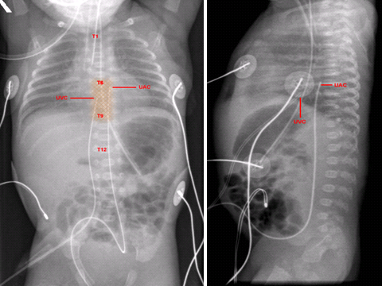
Optimal Positioning of High UAC & UVC

Slide 21
Question
An appropriately placed UVC is placed between which 2 structures to avoid?
Liver (portal vein)
Right atrium

Slide 22
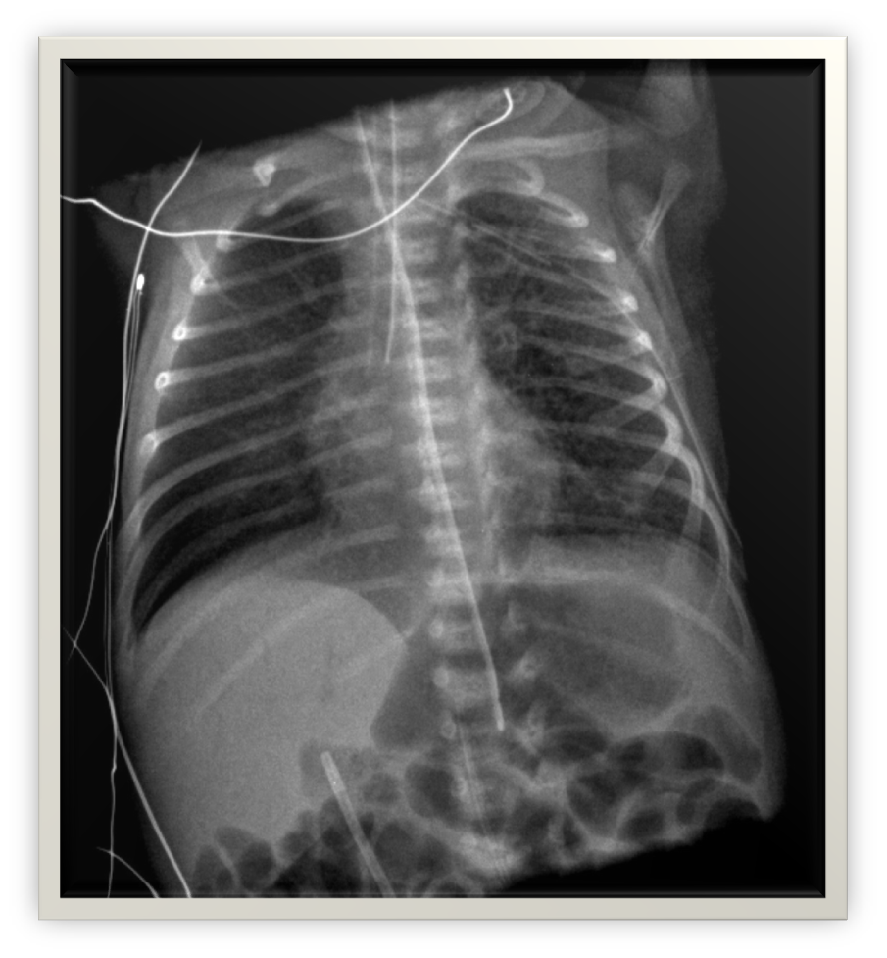
What is the abnormality seen?
Portal venous gas introduced from air in UVC
Notes:
What’s the line related finding?

Slide 23
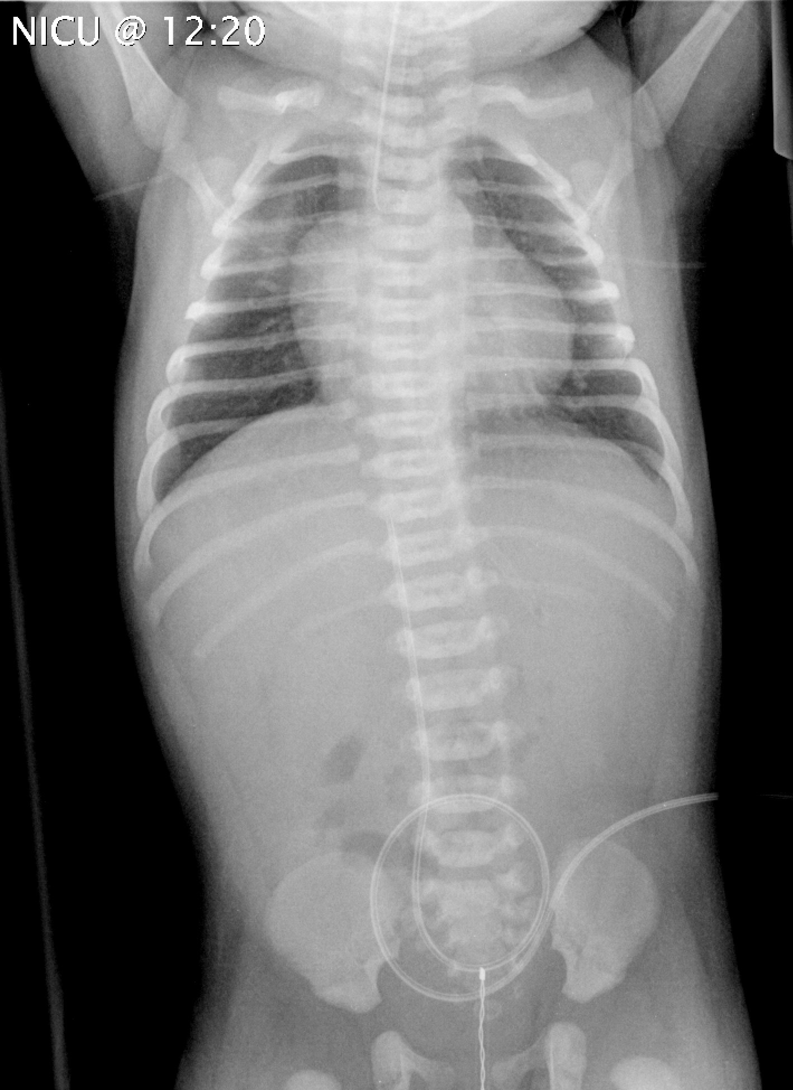
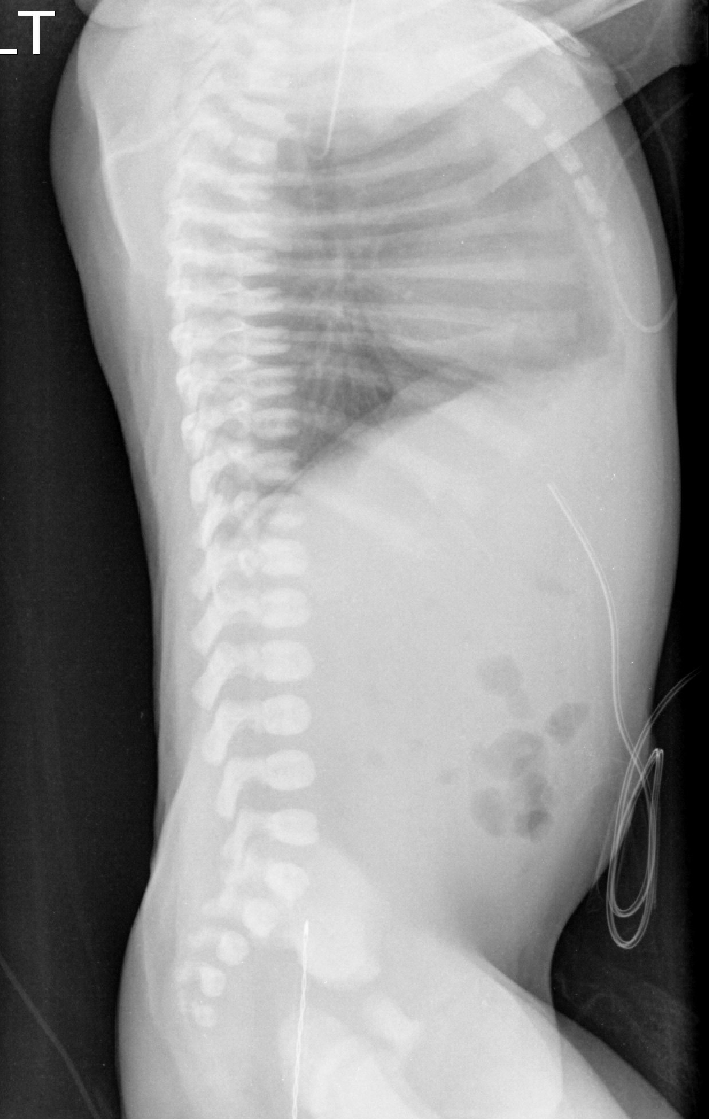
Where’s the UV line tip? Do you need to adjust the UV position?

Slide 24
Two UV lines which line is mal-positioned?
UV 1
UV 2

Slide 25
UV 1

Slide 26
UV 2
Notes:
Moderate RDS, UVC high

Slide 27
Umbilical Catheter Insertion Depth
Goal: accurate positioning on first insertion
Mal-positioning on initial insertion results in:
↑ infant handling
↑ radiation exposure
↑ infection risk (2° line manipulation)
Several methods available to determine depth of insertion; most commonly used:
Dunn (1966): shoulder umbilicus length nomogram
Shukla & Ferrara (1986): weight formula

Slide 28
Shukla & Ferrara Formula
UA catheter length (cm) = 3•BW (kg) + 9
UV catheter length (cm) = ½ UA line calculation + 1
Remember to add length of umbilical stump

Slide 29
Sample Calculations
UAC
(weight in kg x 3 + 9 )+ length umbilical stump (cm)
2 kg infant: umbilical stump 1 cm
(2 kg X 3 + 9 ) + 1 =15 + 1 =16 cm
UVC
[(weight in kg x 3 + 9) ÷ 2] + 1 + length umbilical stump (cm)
3 kg infant: umbilical stump 2 cm
[(3 kg X 3 + 9) ÷ 2] + 1 + 2 = (18 ÷ 2) + 1 + 2 = 12 cm

Slide 30
Skin Antisepsis
Ensure no excess solution pools on skin – especially for preterm infants | Umbilical Catheter Insertion
BW < 1000 g AND ≤ 48 hours old | Apply 2% chlorhexidine with 70% isopropyl alcohol Apply to umbilical cord only Establish sterile field as close as possible to umbilical cord If any solution comes in contact with the skin, remove with sterile water or normal saline
BW < 1000 g AND > 48 hours old | Apply 2% chlorhexidine with 70% isopropyl alcohol Apply sparingly to smallest area necessary to complete procedure Remove immediately at procedure completion with sterile water or normal saline
BW > 1000 g OR BW < 1000 g AND > 14 days of age | Apply 2% chlorhexidine with 70% isopropyl alcohol Do not wipe off Apply to smallest area necessary to complete procedure

Slide 31
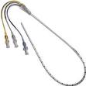
CENTRAL LINE CONNECTIONS

Slide 32
Equipment
Sterile gown/gloves
Non-sterile hat, mask, face shield or eye protection
Neonatal Tray: straight iris forceps, 2 smooth curved iris forceps, 3 mosquito hemostat, needle driver, dilator, sterile gauze, sterile drapes/towels, drape with hole
Umbilical tie, 11 blade scalpel, umbilical catheter
< 1.5 kg: 3.5 Fr ≥ 1.5 kg: 5 Fr
4.0 silk suture, 10 ml sterile NACL syringes, skin antisepsis solution, 3-5 mL sterile syringes
UAC: 3 way stopcock
See next slides for UVC line connections

Slide 33
Single lumen UVC…..What You Need…..STERILE FIELD
Separate MCC
Straight extension piece
For the lumen you will need one of the following:
-extension piece with clamp
-10 ml 0.9% NaCl sterile syringe
-1 microclave clear device
(MCC device is changed q 96 hr)

Slide 34
Double lumen UVC…..What You Need….Sterile Field
For each lumen you will need one of the following:
-10 ml 0.9% NaCl sterile syringe
-1 microclave clear device
Dropped onto the sterile field
After insertion – aseptic connection – “scrub the hub” add Bi or Tri MCC extension set directly to MCC device for infusion(s) and medication delivery
Notes:
Demo/Station: Have sterile field site – and required supplies that are required for procedure and review the steps in terms of preparation /”assistance’s” role

Slide 35
☼Practice Variation Heparin & UVCs
: heparin
: no heparin
: no heparin

Slide 36
Complications of Umbilical Catheters
Infection
Vascular Accident
NEC, embolus, thrombus, vasospasm
Peritoneal perforation
Mal-position in heart or great vessels
Pericardial effusion or cardiac tamponade, arrhythmias
Malposition in midclavicular region
Pleural effusion
Mal-position in portal system
Hepatic necrosis
Hepatic abscess
Portal venous thrombosis
Refractory hypoglycemia

Slide 37
Insertion Challenges

Slide 38
Problem: UVC meets resistance before reaching pre-determined insertion length
Cause:
UVC likely entered portal venous system
UVC may have doubled back on itself
Action:
Pull back UVC to 3 cm
While reinserting, rotate catheter; this may allow UVC tip to slip through ductus venosus
Flush catheter gently while slowly advancing slowly
Try latero-posterior hepatic mobilization to realign umbilical vein, portal vein and ductus venosus
Arch Pediatr 2010 Oct;17(10):1440-1444

Slide 39
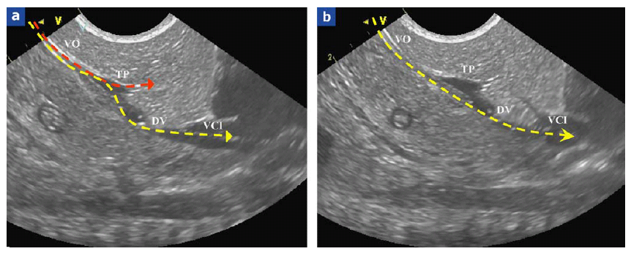
Lateroposterior Liver Mobilization
Pre-liver mobilization
Post-liver mobilization
Realignment of umbilical vein (VO), portal vein (TP) & ductus venosus (DV) to allow catheter to enter inferior vena cava (VCI)
Pennaforte. Arch Pediatr 2010;12(10):1440-1444

Slide 40
Despite studies supporting the method of attempting to insert a second catheter into the same vessel while the misdirected catheter is in place, this practice is NOT recommended as this may cause vessel damage and/or thrombus formation
Davies. Arch Dis Child Fetal Neonat 1998;78:F234
Mandel et al. J Pediatr 2001;139:591-2
Al-Essa et al. Med Princ Pract 2005;14:98-101
Palanivel V. Ind J Pediatr 2009;76:1186

Slide 41
UVC’s in or near Liver
Never leave UVC in portal vein
Replace with properly positioned UVC OR
Pull to low position out of portal system into umbilical vein
Low UVC’s
May use for non-vesicant solutions for 1-2 days until more suitable access obtained
UVC in liver

Slide 42
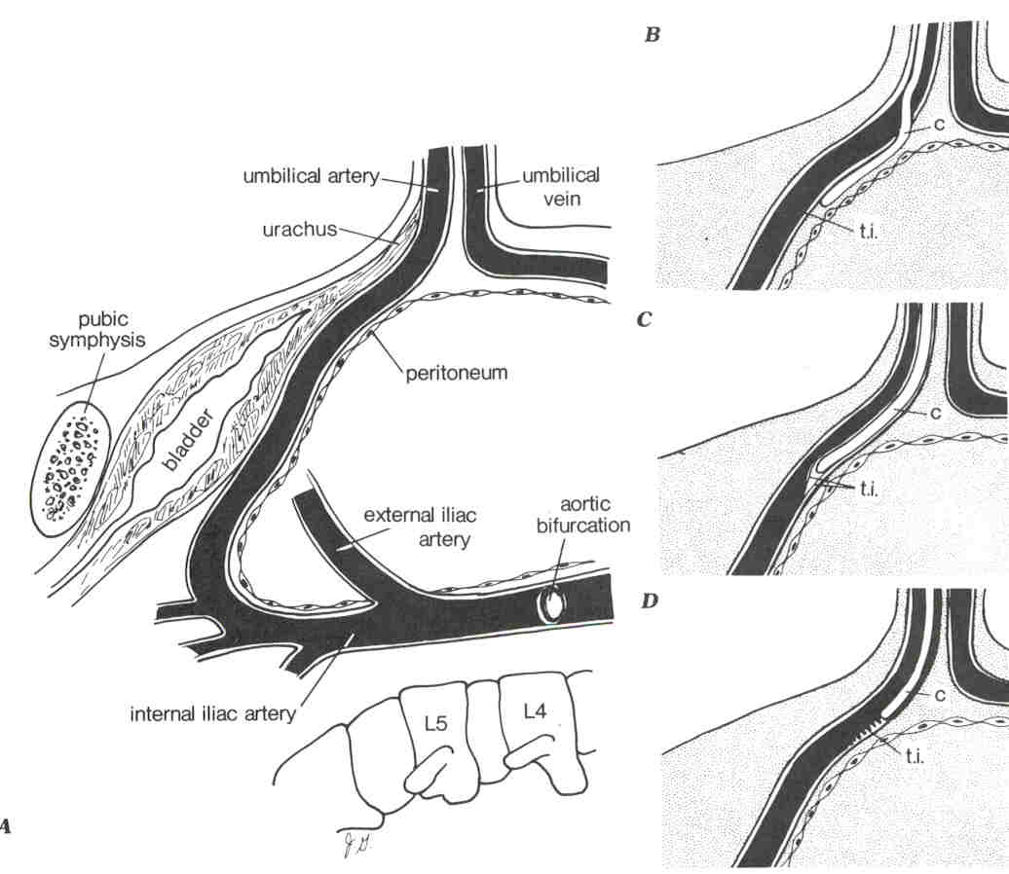
Problem: UAC meets resistance at insertion depth of ~4 cm
Cause:
False tracked or unable to get around sharp turn in vessel as it angles around bladder toward internal iliac artery
Action:
Apply gentle steady pressure for ~ 30-60 sec on abdo. Vessel should slowly relax; do not force. Risk of peritoneal or vascular perforation, should not “pop”
Remove if persisting resistance or failure of blood return
Position infant with side with catheter elevated, flex hip
Point of resistance
Atlas of Procedures 2007

Slide 43
Problem: UAC inserted to appropriate depth with no resistance but right leg goes pale
Cause:
Arterial vasospasm from catheter insertion
Action:
Warm contralateral (left) leg
If no improvement, remove catheter

Slide 44
What abnormality is seen?
Portal venous gas introduced from air in UVC
Notes:
What’s the line related finding?

Slide 45
Prevention of Air Embolism Risk
Never leave catheter open to air (e.g. during disconnection) and always ensure a closed system
Fill catheter with infusion solution, leave fluid-filled syringe attached to catheter
Immediately prior to insertion, re-prime the catheter and check catheter and attached system for air

Slide 46
Procedural Videos: Sterile Preparation New England Journal
LEARNING ACTIVITY

Slide 47
Demonstration & Practice:
INSERTION
SUTURING & SECURING

Slide 48
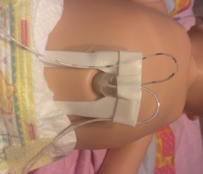
Line Stabilization
Notes:
Demo: Review new securing device and this method as well.

Slide 49
Catheter Removal Discussion

